Slide 1
Nursing Knowledge Big Data Science Initiative:
Where have we been?
Where are we going?
Connie W. Delaney PhD, RN, FAAN, FACMI, FNAP
Bonnie L. Westra PhD, RN, FAAN, FACMI

Slide 2
Objectives
Provide a context synthesis for the Nursing Knowledge Big Data Science Initiative 2013-2018
Describe the methods for making progress over the years
Suggest future possibilities for achieving sharable and comparable nurse-sensitive data to improve health and health care

Slide 3
Nurses Call to Action
Nursing information is not captured in ways that make it sharable and comparable – essential for “big data” for quality improvement and research to improve patient safety outcomes
Nursing has a long history of informatics development; however implementation lags

Slide 4
Primary Goal is…..
To guide consistent documentation and data collection to support sharable and comparable nurse-sensitive data to improve health and health care.

Slide 5
Linkage of Data for
Minimum Data Sets & Nursing
  Nursing Care Elements
    1. Nursing Diagnoses
    2. Nursing Interventions
    3. Nursing Outcomes
    4. Nursing Intensity of Care
  Patient Demographics
    5. * Personal Identification
    6. * Date of Birth
    7. * Sex
    8. * Race
    9. * Ethnicity
    10. * Residence
    Service
    11. * Unique facility or agency number
    12. Unique number of principle RN
    13. * Episode Admission or Encounter Date
    14. * Discharge or Termination Date
    15. * Disposition of patient or client
    16. * Expected payer for this bill
  Environment
    1. Unit/Service Unique Identifier
    2. Type Of Nursing Delivery Unit/Service
    3. Patient/Client Population
    4. Volume Of Nursing Delivery Unit/Service
    5. Care Delivery Structure And Outcomes
    6. Patient/Client Accessibility
    7. Clinical Decision Making Complexity
    8. Environmental Complexity
    9. Autonomy
    10. Nursing Delivery Unit/Service Accreditation
  Nurse Resources
    11. Management Demographic Profile
    12. Staff Demographic Profile
    13. Staffing
    14. Satisfaction
  Financial Resources
    15. Payer Type
    16. Reimbursement
    17. Nursing Delivery Unit/Service Budget
    18. Expenses

Slide 6
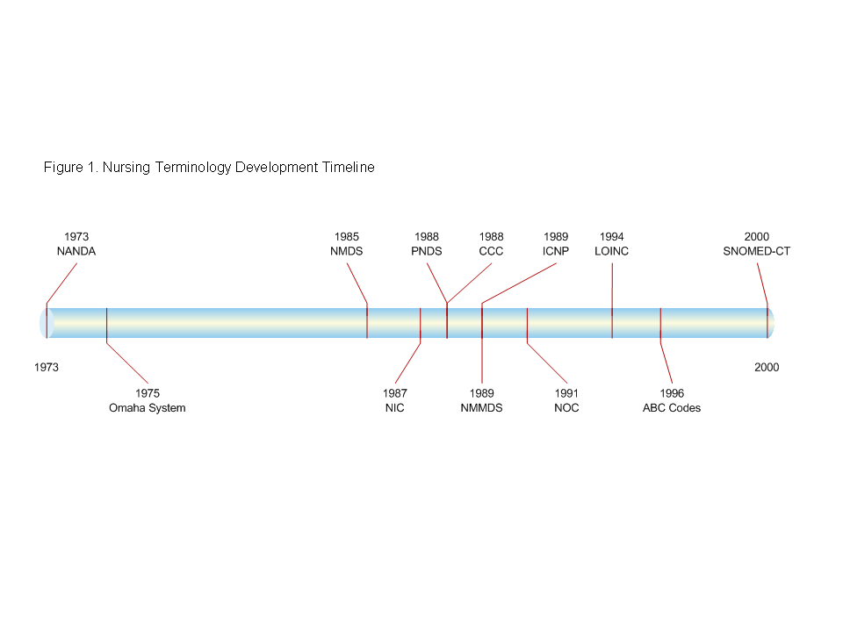
Development/ Recognition of Nursing Terminologies
ANA Recognition
Westra, B.L., Delaney, C.W., Konicek, D., & Keenan, G. (2008). Nursing Standards to Support the Electronic Health Record. Nursing Outlook, 56, 258-266.e1

Slide 7
ANA NIDSECSM
Nursing Information & Data Set Evaluation Center (ANA, 1995)
To evaluate information systems that support the documentation of nursing practice.
Notes:
In December 1995, the ANA Board of Directors approved the establishment of the Nursing Information and Data Set Evaluation Center (NIDSEC). These standards are used in the ANA recognition program of information systems that support nursing practice
The NIDSEC originated from a proposal by a joint Task Force appointed by the Congress of Nursing Practice Steering Committee on Databases to Support Clinical Nursing Practice and the Congress of Nursing Practice Committee on Nursing Practice Standards and Guidelines.
Guidelines and Standards of Care:
NIDSEC has developed standards to evaluate four dimensions of nursing data sets and the systems that contain them.

Slide 8
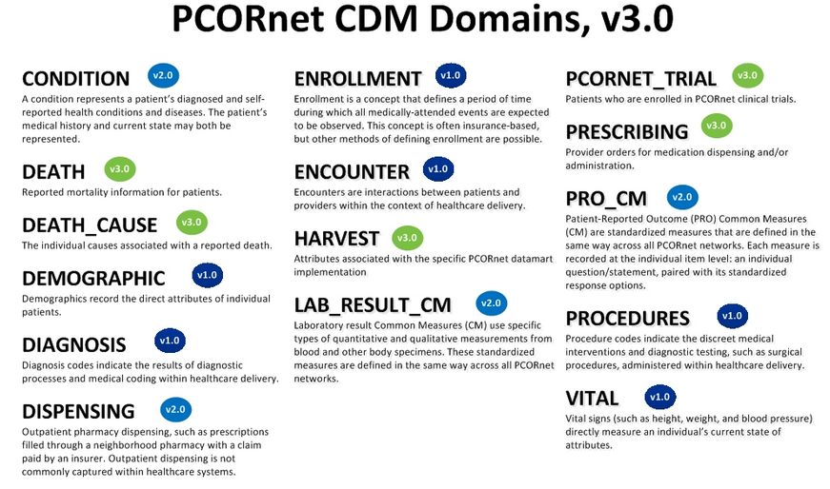
http://www.pcornet.org/resource-center/pcornet-common-data-model/

Slide 9
Data Warehouse
Clinical Data
NMDS
Management Data
NMMDS
Other Data Sets
Continuum of Care
9
Notes:
9
Assumption today is that clinical data = medical data
UHDDS captures some of the NMDS, but missing nursing care elements
Management data - missing
Environment, Nursing resources, Financial resources

Slide 10
Nursing Knowledge:
Big Data Research
for Transforming Healthcare
2013 Big Data Conference
August 12-13, 2013

Slide 11
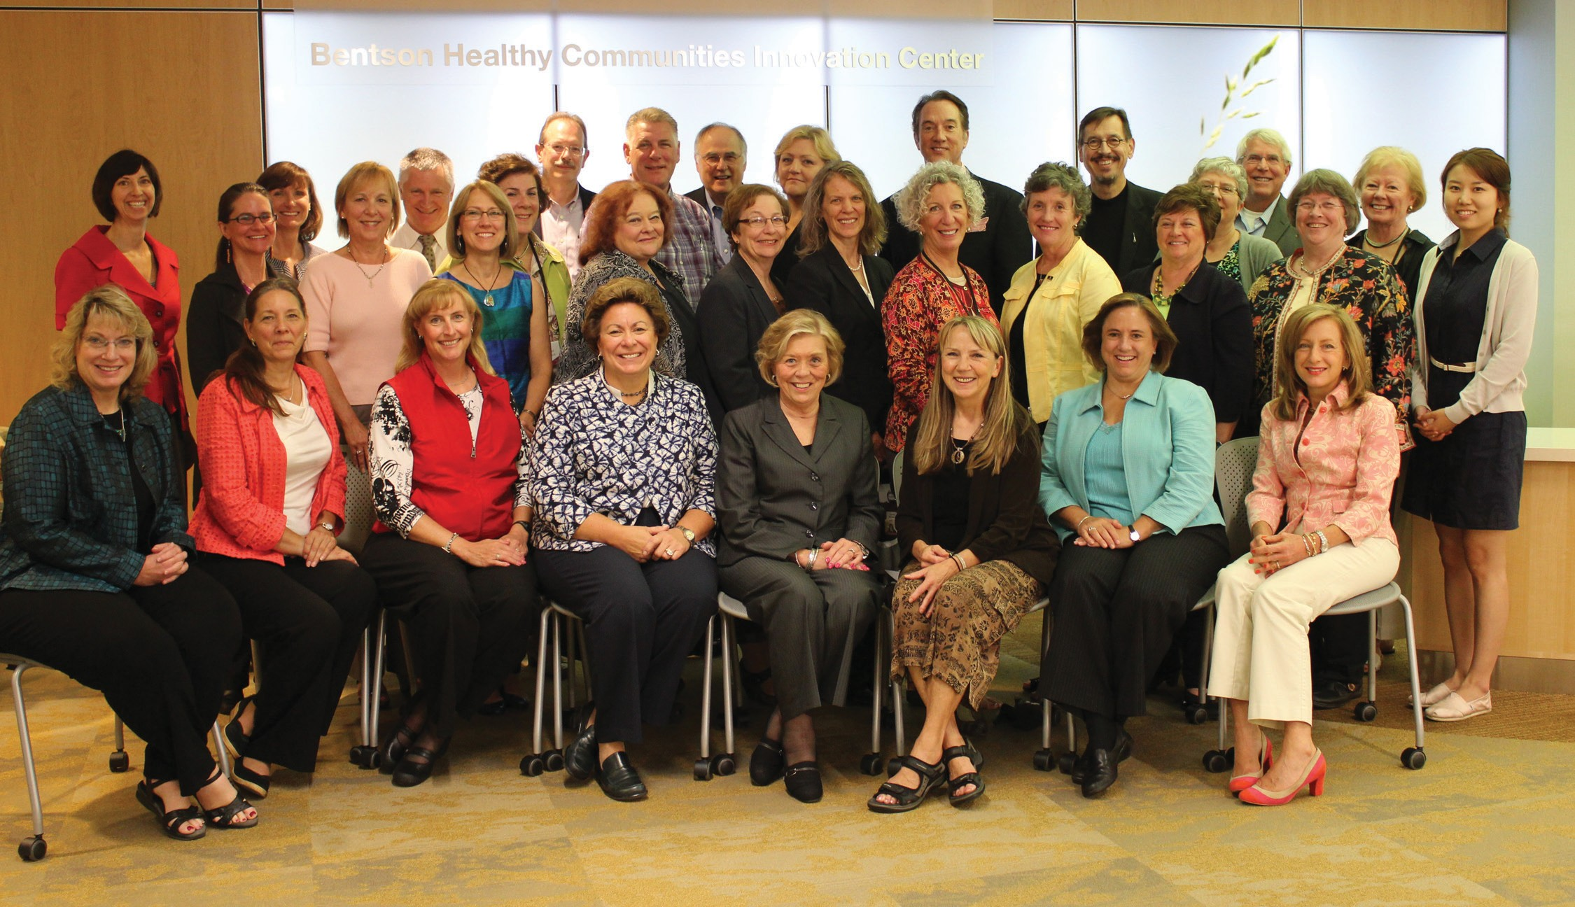
2013 Conference Attendees (invitational)

Slide 12
Nursing Knowledge:
Big Data Research for Transforming Healthcare
Vision
Better health outcomes result from
  standardization and integration of the information nurses gather in electronic health records and other information systems,
  addition of contextual data about patients,
  environmental, geographical, behavioral, imaging, and more
  Nursing data is increasingly the source of insights and evidence used to prevent, diagnose, treat and evaluate health conditions.
Inclusion of nursing data leads to breakthroughs for the health of individuals, families, communities and populations.

Slide 13
2013 Recommendations (RoadMap)
Design, build and implement health information systems to comply with regulations and standards
  SNOMED-CT and LOINC for exchange of nursing data
  Does not preclude use of other nursing standardized languages
Participate in standards development to ensure a nursing voice
  Voice is defined as the data, information, and knowledge that nurses need to provide and make decisions about safe patient care

Slide 14
2013 Recommendations (RoadMap)
Survey health systems about perceived value and current use of standardized nursing terminologies for documentation, quality improvement, and research
Create a central resource for
  mapping nursing data to terminologies – particularly assessments, interventions, and outcomes.
  Best practices through the National Library of Medicine or a repository
Work with vendors to include standardized nursing terminologies, eliminating the need for each health system to map local codes to standards

Slide 15
2013 Recommendations (RoadMap)
Require coding in information systems to be consistent with the NMDS/ NMMDS data elements – new nursing knowledge model
Integrate the NIDSEC criteria into meaningful use certification criteria of EHRs
Share the nursing knowledge model across CTSAs to include in their clinical data warehouses

Slide 16
2013 Recommendations (RoadMap)
Empower nurses and other informaticians to value and advocate for standardized nursing terminologies and the value of these
  Implies action
Develop strategies to work with nursing organizations on a common set of goals and consistent reporting on progress
  Collaboration

Slide 17
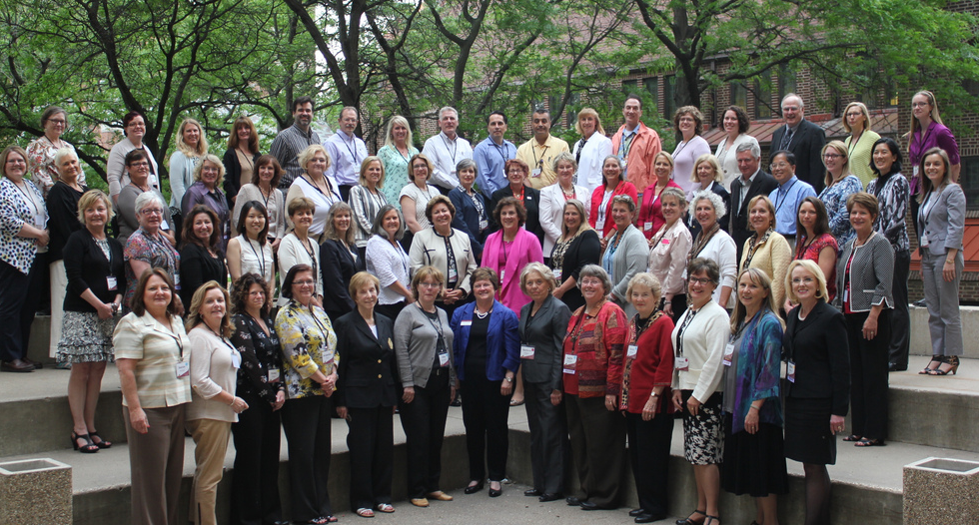
2014 Conference Attendees

Slide 18
2014 - 2018
Continued with annual think-tank working conference
Pre-conference – extended education to inform conference work
Formed virtual workgroups to accomplish the work
  Work built on and expanded existing efforts
Expanded collaboration with many organizations

Slide 19
Nursing Big Data Science Workgroups
Care Coordination
Clinical Data Analytics
Context of Care
Education
Encoding/ Modeling
Engage Nurses in Health IT Policy
Mobile Health Data
Nursing Value
Social Behavioral Determinants of Health
Transform Documentation
Repository Project

Slide 20
Example of Accomplishments
Develop standard curriculum for nursing faculty to teach informatics
Develop strategies to measure value of nursing
Develop methods for validating information models and LOINC/SNOMED CT coding integrated into interprofessional standards
Promote use of the National Provider Identifier for registered nurses

Slide 21
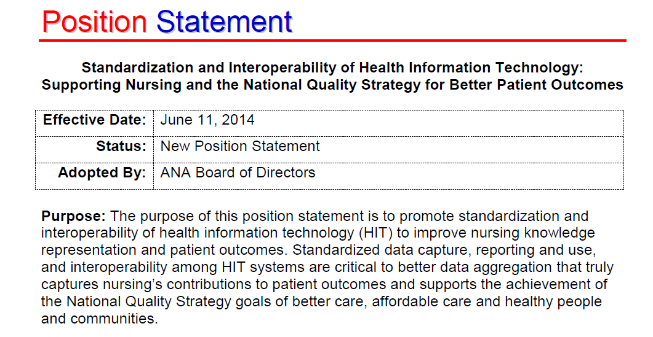

Slide 22
Nursing Knowledge Big Data Science Initiative:
Where are we going?
Future possibilities for achieving sharable and comparable nurse-sensitive data to improve health and health care

Slide 23
Lens into Nursing Big Data Participants
“by the numbers”
2013 - ~30 people (invited) ; 3 workgroups created
2014 - ~60 people; continued same 3 same workgroups
2015 - ~110 people; 10 workgroups - ~ 100-200 members
2016 - ~170 people; 12 workgroups - ~180 members
2017 -~150 people; 10 workgroups - ~250 members
2018 - ~150 people - 10 workgroups - ~350 members; some workgroups have 6 subgroups

Slide 24
Lens into Nursing Big Data Participants leadership evolution for transformation
  Knowledge representation that is wholistic
  Transcending the “I” to create “We”
Tri-mission related to Health, Health Care
  Interdisciplinary/interprofessional
  Team
  Collaboration
  Transparency

Slide 25
2017 Nursing Big Data Conference transformative moment
Call for Interprofessional engagement
  National Center for Interprofessional Practice & Education
Call for social media
  LinkedIn
  Power of transparency & sharing:
  eRepository
  Nursing Big Data LI platform

Slide 26

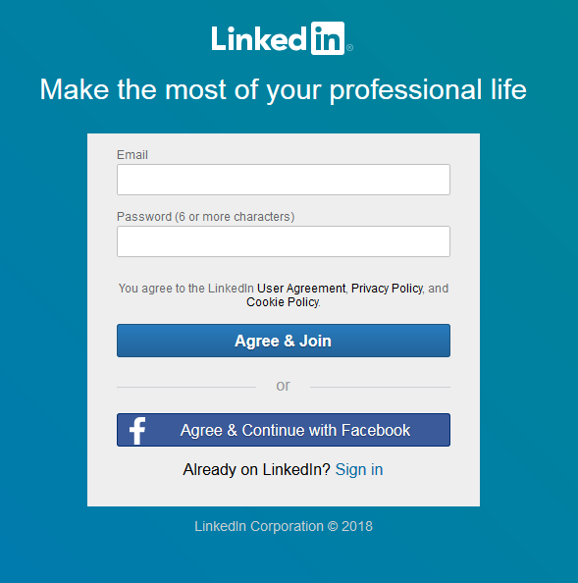
Prior to the June 14 LinkedIn Session could all participants please:
Download the LinkedIn app on their phones
Set up a LinkedIn Account:
  Type in www.linkedin.com
  Complete the information on the website
Thank you,
Anne
www.linkedin.com/in/annepryor

Slide 27
Minnesota Nursing Informatics Leadership Inventory (MNILI)
https://www.surveymonkey.com/r/MNILI
Your participation will help define the science of nursing informatics leadership
MNILI will be available in the public domain for use in education and research
Thank you!

Slide 28
ANA/ONC Survey
You will receive an email of invitation
Your participation is an individual choice
Thank you!
Revised ANA Position Statement, Inclusion of Recognized Terminologies Supporting Nursing Practice within Electronic Health Records and Other Health Information Technology Solutions, that was reaffirmed/approved by the Board of Directors on April 19, 2018.

Slide 29

Could it be that your work empowers:
Knowledge representation and standards that represent East/West integration?
Partnership and team that integrates mind-heart?
Policy that is transformative?
Care that is person-centric?
Realizing the Quadruple aim?
Us to initiate that next phase of knowing - that of intuition?

Slide 30
Could it be that your work empowers:
Us to boldly impact community through social media, leveraging individual to group engagement?
Us to welcome our impact
on planetary health?
Convergence of our work, growth in our science, linkage of academic-service technology, and transformative health policy that reinvigorate our purpose for being nurses, nursing, and most significantly our person-centered and population care?

Slide 31
Nursing Knowledge Big Data Science Initiative:
Where have we been?
Where are we going?
Connie W. Delaney PhD, RN, FAAN, FACMI, FNAP
Bonnie L. Westra PhD, RN, FAAN, FACMI

