Slide 1
"If you cannot name it, you cannot control it, finance it, research it, teach it, or put it into public policy."
Norma Lang, PhD, RN, FAAN, FRCN (1990)
Classification for Nursing Practice,“ International Nursing Review, 39
no. 4, (1992): 109-112.

Slide 2
Nursing Knowledge: Big Data Vision
“We share a vision of better health outcomes that will result from the standardization and integration of the information nurses gather in electronic health records, which is increasingly the source of insights and evidence used to prevent, diagnose, treat, and evaluate health conditions. The addition of rich contextual data about patients (including environmental, geographical, behavioral, imaging data, and more) will lead to breakthroughs for the health of individuals, families, communities, and populations.”
Notes:
FULL STATEMENT:
Current as of 9-2016 (Bonnie Westra confirmed)
We really need to call out Connie and Bonnie’s leadership as this collaboration has been amazingly successful in creating a shared vision and closing gaps that have existed for 30+ years.
We encourage you to visit the website and learn more about the exciting work efforts and then JOIN one-–we need the collective wisdom and ideas.
You can just search “Nursing big data” and find the website

Slide 3
Nursing Knowledge: Big Data Vision
Ability to share and compare nursing data across organizations.
Better quality outcomes will result from the standardization and integration of the information nurses enter in EHRs.
Leading to better health of individuals, families, communities, and populations.
Notes:
Abbreviated Version

Slide 4
2019 Workgroups
Clinical Data Analytics
Demonstrate the value of sharable and comparable nurse-sensitive data to support practice and translational research for transforming health care and improving patient quality and safety. The subgroups are: Data Science, Population Health Informatics, and Validation of Information Models.
Care Coordination
To identify shareable and comparable data across settings to support care coordination activities and improve patient outcomes.
Notes:
The Clinical Data Analytics group projects:
Develop nursing information model for Pain, derived from what is actually being documented in EHRs
Incorporate nursing data into national research common data models

Slide 5
2019 Workgroups
Engage & Equip Nurses in HIT Policy
Equip nurses with education, tools and resources and engage them as knowledgeable advocates for health IT policy efforts important to nursing.
Context of Care
Demonstrate sharable and comparable nurse data across the care continuum by capturing nursing “big data” in the Nursing Management Minimum Data Set (NMMDS), the Nursing Minimum Data Set (NMDS) and the Nursing Knowledge: Big Data Science Conference Nursing Value Data Set (NVDS) to increase nurse data usability, provide patient, family and community centric data and, fortify data generated by nurses, about nurses and nursing care across the care continuum and across care transitions in all settings where nurses provide care.
Notes:
Nursing is underrepresented when it comes to Health IT policy and yet nursing is the largest clinician group using HIT.
The NMMDS was developed to support nurse executive decision making and to compare effectiveness across settings. The Context of Care group is looking at how use of the NMMDS can be used to look at nursing’s role and contribution to the quadruple aim: Better Care, Better Health, Lower Cost and the more recent addition of improving the caregiver’s experience.

Slide 6
2019 Workgroups
Education
Ensure that faculty and system’s educators who impact practicing nurses and nursing students are competent and capable to mentor those they influence to be full participants or leaders in a technology rich environment where they are able to use information technology to process data to form information and knowledge.
Nursing Value
To measure the value of nursing care as well as the contribution of individual nurses to clinical outcomes and cost. Develop big data techniques for secondary data analysis that will provide metrics to monitor quality, costs, performance, effectiveness, and efficiency of nursing care.
Notes:
We need to support faculty with the right knowledge, tools, resources, and curriculum to incorporate informatics content and competencies into all levels of education.
Demonstrating the value of nursing care requires objective and replicable measures, and this evolving model will leverage current data collection with a couple of additions that may not currently be available. The NPI is a prime example-–NPIs are not just for billing providers. And by the way, it takes about 10 minutes to apply online and less than 5 minutes to receive your NPI.

Slide 7
2019 Workgroups
Mobile Health for Nursing
Explore the use of mobile health (mHealth) data by nurses including both nursing-generated data and patient-generated data. Identify and support activities and resources to address unmet needs and create opportunities to utilize mHealth data within nursing workflows.
Social/Behavioral Determinants of Health
Support the inclusion, interoperability and data exchange of Social Determinants of Health (SDOH) data in electronic health records, personal and m-health tools, community and public health portals across care settings. Empower nurses (practice, education, research, policy) to use SDOH data as context for planning and evaluating care. Develop a roadmap to engage nurses to improve population health through large-scale adoption of SDOH.
Notes:
mHealth is exploding and new companies with new products emerge daily. Nurses can help to inform the usefullness and the usability of mHealth as well as leading patient advocacy for mHealth.
Social and Behavioral Determinants of Health have long been included in the nursing process, but have been invisible. As technology matures, an electronic longitudinal care plan is now feasible and the development of a shared model and toolkit is critical to maintaining nursing visibility in the care process.

Slide 8
2019 Workgroups
Transform Nursing Documentation
Move from discipline-specific documentation silos toward a more useful representation of the patient story; continuum patient-centered documentation; decrease the documentation burden.
Define a model for Nursing Admission History & Screening
Encoding & Modeling Nursing Data
Enable interoperable nursing data in EHRs with Logical Observation Identifiers Names and Codes (LOINC®) and SNOMED CT®, & develop governance for nursing information model creation and curation
Notes:
Transforming Nursing Documentation is focused on targeted interprofessional documentation in EHRs that better supports clinical decisions and patient decisions, incorporating the best evidence available—Precision Nursing is the goal.
Encoding and modeling Data—this group is working to code nursing/interprofessional assessment data according to the federal standards (LOINC and SNOMED CT) and is broadening scope to all elements of the nursing process based on use case. Implementation of coded assessments and other data elements into EHRs will be piloted.

Slide 9
Standardizing Nursing Data
Acknowledgement:
Susan A. Matney, PhD, RNC-OB, FAAN, FACMI, FHIMSS Intermountain Health
Notes:
Want to especially acknowledge Susan Matney, who launched this workgroup.
Susan and Judy Warren are leading experts in modeling and coding nursing documentation.

Slide 10
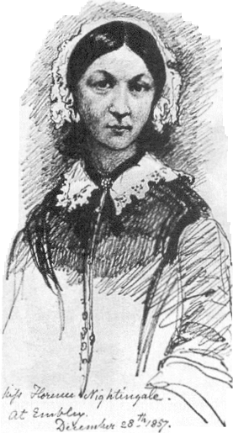
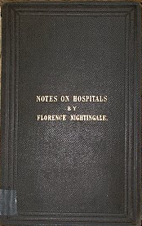
Florence Nightingale, 1863
In attempting to arrive at the truth, I have applied everywhere for information, but in scarcely an instance have I been able to obtain hospital records fit for any purpose of comparison. If they could be obtained they would enable us to decide many other questions besides the one alluded to. They would show the subscribers how their money was being spent, what good was really being done with it, or whether the money was not doing mischief rather than good.
Nightingale, F. (1863). Notes on Hospitals. London; Longman, Green, Longman, Roberts, & Green, p. 176
Re-used from J. Warren 2014 presentation
Notes:
Florence Nightingale lamented about the lack of data ‘fit for analysis’ over 150 years ago.
Nursing has been working on standard representation of our data for more than 40 years.
NANDA was the first standard, for nursing diagnoses, developed in 1973. Omaha, representing nursing diagnoses, interventions, and outcomes debuted in 1975. The ANA began to recognize terminologies and classifications in 1992, and currently the list stands at 12.
NANDA, Omaha, NMDS, NIC, PNDS, CCC, NMMDS, ICNP, NOC, LOINC, ABC, SNOMED Clinical Terms
LOINC and SNOMED CT represent the federal standards for interoperable nursing data.

Slide 11
Standardized Data: Benefits
Measure the contributions of nursing within the interprofessional team context
Support ‘Value of Nursing’ measurement
Enable eCQMs
Enhance care coordination across the continuum (nursing data in C-CDA)
Enable cross-institutional nursing-sensitive outcomes studies and quality improvement initiatives
Notes:
What’s in it for us?
Make VISIBLE nursing and nursing’s contribution to patient, family, population health outcomes. Let’s demonstrate what we intuitively know about nursing’s value to the world…
eCQM stands for electronic clinical quality measures, which is an evolving requirement for meaningful use and now, MACRA. We will be expected to extract quality measures from our EHRs.
Nursing assessments, diagnoses, interventions, outcomes are now included in the ONCs data standards—see 2017 Interoperability Standards Advisory.
Because our focus is not just a medical diagnosis, but a holistic perspective of enabling human beings to the highest possible state of health, from that individual’s perspective and personal goals, nursing’s care plan additions are by nature longitudinal yet are not always incorporated into health information exchange at transition of care. The ANA is calling for that situation to change—it will require us to use the ONC standards of LOINC and SNOMED CT to ensure interoperability (2015 ANA Position Statement).

Slide 12
National Nursing Statements and Initiatives regarding Interoperability

Slide 13
Inclusion of Recognized Terminologies Supporting Nursing Practice within Electronic Health Records and Other Health Information Technology Solutions
Purpose:
Support for the use of recognized terminologies supporting nursing practice
Promote integration of terminologies into information technology solutions
Facilitate interoperability between different concepts, nomenclatures, and information systems
http://www.nursingworld.org/MainMenuCategories/Policy-Advocacy/Positions-and-Resolutions/ANAPositionStatements/Position-Statements-Alphabetically/Inclusion-of-Recognized-Terminologies-within-EHRs.html
Notes:
Mention there are seven interface terminologies recognized by nursing.

Slide 14
Inclusion of Recognized Terminologies Supporting Nursing Practice within Electronic Health Records and Other Health Information Technology Solutions
4. When exchanging a Consolidated Continuity of Care Document (C-CDA) with another setting for problems and care plans, SNOMED CT® and LOINC® should be used for exchange. LOINC® should be used for coding nursing assessments and outcomes and SNOMED CT® for problems, interventions, and observation findings.

Slide 15
http://www.himss.org/big10

Slide 16
Recommendations
Promote Standards and Interoperability
1) Nurses should promote the use of standardized and accepted terminologies that address the documentation needs of the entire care team regardless of care setting. All care delivery settings should create a plan for implementing an ANA-recognized nursing terminology that is mapped to national standards i.e. SNOMED CT or LOINC
http://www.himss.org/big10
Notes:
The ability for nurses to make optimal clinical decisions is dependent upon having access to accurate, real-time information regardless of care setting. Data must also be structured in standard ways to enable sharable, comparable information.

Slide 17
NLM Nursing Resources for Standards and Interoperability
NLM a web page developed to:
Describe use of SNOMED CT and LOINC in implementing Meaningful Use relevant to the nursing community,
Information about nursing terminologies,
National and international collaboration efforts to harmonize nursing terminologies and facilitate interoperability,
Demonstration of the UMLS to extract synonymy between SNOMED CT, LOINC, and nursing terminologies,
Links to additional resources relevant for nursing clinical documentation purposes.

Slide 18
NLM Nursing Resources for Standards and Interoperability
https://www.nlm.nih.gov/research/umls/Snomed/nursing_terminology_resources.html

Slide 19
Alliance for Nursing Informatics
Mission, Vision and Core Values of ANI
Vision: Transform health and health care through nursing informatics and innovation
Mission: To advance nursing informatics leadership, practice, education, policy and research through a unified voice of nursing informatics organizations
ISA Feedback provided by a ANI group led by Sarah Collins, PhD, RN
http://www.allianceni.org

Slide 20
2019 Interoperability Standards Advisory (ONC) for Nursing
Clinical/Nursing Assessments
Observations: LOINC
Observation Values (answers): SNOMED CT, except when the values are validated scales coded in LOINC
Nursing Interventions
SNOMED CT
Outcomes for Nursing
Observations: LOINC
Observation Values (answers): SNOMED CT if observed assessment, LOINC if a measurement
Patient Problems for Nursing
SNOMED CT
https://www.healthit.gov/isa/sites/isa/files/inline-files/2019ISAReferenceEdition.pdf.

Slide 21
IHTSDO News Release
Nursing Problem List Subset
http://ihtsdo.org/fileadmin/user_upload/Docs_01/Publications/SNOMED_CT/SnomedCt_MeaningfulUse_20140219.pdf

Slide 22
Coding Workgroup
Objectives:
Create a framework for organizing nursing data
Map observations (the ‘questions’) to LOINC
Map observation values (the ‘answers’) to SNOMED CT
Map interventions to SNOMED CT
Map outcomes to LOINC (if measurement) or SNOMED CT (if observed assessment)
Determine the LOINC & SNOMED CT coverage; submit new concepts as needed

Slide 23
First Project: Top 100 Assessments
Objectives:
Create a framework for organizing assessment data in LOINC
Map observations (the ‘questions’) to LOINC
Map values (the ‘answers’) to SNOMED CT
Determine the LOINC coverage for frequently documented assessment questions & submit new concepts as needed
Determine SNOMED CT coverage for the frequently documented assessment values (answers) & submit new concepts as needed
Notes:
Much work has been done in the past 10 years or so to coding various nursing classifications and terminologies to SNOMED CT. Almost no assessment data had been coded, which is why we focused our attention on assessments.
The workgroup goals were
To identify the common assessment measures used in nursing, map them to LOINC, place them in a framework and publish in a public location.
To identify the values associated with the common enumerated assessment measures and map them to SNOMED CT.

Slide 24
Westra et al
Notes:
We started with physiologic assessments, reasoning that the top 100 data elements would reflect primarily physiologic assessments. That was mostly true , though some might argue that Pain actually belongs in the psychological domain.

Slide 25
Approach
Compared top 100 physiologic assessment measures from six institutions
submitted 61 – 128 observations
68 unique concepts used by 2 or more sources
Mapped to LOINC (70%)
Grouped observations according to physiological system (for Panels and Framework)
Created assessment panels by system
Evaluated observations in panels to ensure a nursing assessment minimum data set
Identified observation values.
Initial Scope: Med-Surg WDL panels

Slide 26
WDL Documentation
Each institution has WDL parameters defined.
Skin WDL example
Skin Color = normal for ethnicity
Skin Temperature = Warm
Skin Moisture = Dry
“Impression” codes are used to document a nursing judgment.
WDL is one value for the impression observation.
If there is concerns, risks, etc. this would be documented as text for this code
When WDL is selected, the “Defined Limits” name/value pairs must store on the back-end (Epic does this already)

Slide 27
Results
15 Standardized Nursing med/surg physiologic assessment panels (86% new LOINC)
106 Observations (50% new LOINC)
348 Values (20% new SNOMED CT)
New LOINC codes approved, including “Nursing Impression” for WDL
New SNOMED CT codes approved
WJNR article: “Standardizing physiologic nursing assessment data to enable big data analytics” (Matney, Settergren, Carrington, Richesson, Sheide, Westra, 2016) http://wjn.sagepub.com/content/early/2016/07/18/0193945916659471.full.pdf
Notes:
More work to do, but this is a good start and the coding will be available publically for Nursing to use in their own EHRs—Epic has provided strong support for this work.

Slide 28
LOINC Panels (search.loinc.org)

Slide 29
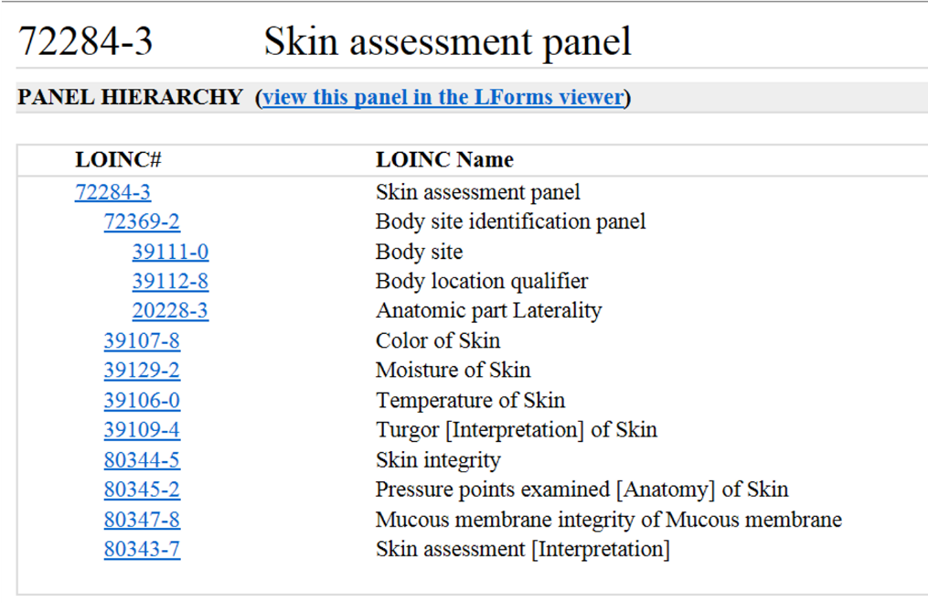
Skin Assessment Panel (partial)

Slide 30
2019-2020 Initiatives
Continue nursing/interprofessional assessment coding to LOINC & SNOMED CT, and expand beyond assessment data based on use cases (Pain, e.g.)
Publish value sets on UMLS (VSAC)
Implement coded data elements into EHRs
Model creation/curation, in alignment with CIMI; create FHIR profiles
Incorporate evidence/clinical knowledge

